Slide 1
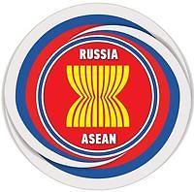
Successful Business Strategy in the ASEAN Market: Perspectives for Russia
International Business Research Project
School of International Affairs
Faculty of World Economy and International Affairs
National Research University Higher School of Economics
Project Head:
Professor Evgeny A. Kanaev
Division Supervisors:
R. Fainshmidt, D. Milkova, Giang Dinh, R. Darnell

Slide 2
Project Goal
To trace the key components of a successful business strategy in the ASEAN market

Slide 3
Project Tasks
Working with academic, expert-analytical, and reference materials in the English language
Searching for and processing statistical information
Working with graphics (charts, tables, graphs), preparing presentations
Understanding the specifications of intercultural communications and business culture in regards to both SEA and the interaction between Russia and ASEAN
Formulating robust expertise and scientific foresight regarding the links of processes taking place in SEA with the Russian Federation’s interests in the Asian-Pacific region

Slide 4
Preparation of materials for the textbook «Business in Southeast Asia: Prerequisites for Success»
Planned Results

Slide 5
Additional information
Duration: 30.10.2017 – 30.04.2018
Number of credits: 4 credits
Remote activities & consultations with the Project Head, Prof. E. Kanaev
Combination of group and individual activities
20 vacancies (for students in Oriental Studies, International Relations and Political Studies)

Slide 6
Grading Criteria for Project Results
Quality and completion of the Project Head’s assignments
Timeliness in presenting both the midterm and final reports
Non-triviality of the conclusions and assessments

Slide 7
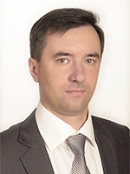
Project Head
Professor Evgeny A. Kanaev
School of International Affairs, Higher School of Economics
Expert in the Russian International Affairs Council (RIAC)
Leading Researcher, Center for Asia-Pacific Studies, IMEMO RAS
Expert in ASEAN Center, MGIMO-University, MFA of Russia
Expert of Russian National Committee, Council for Security and Cooperation in the Asia-Pacific region
Member of Editorial Board, Journals “Southeast Asia: Actual Problems of Development” (Russia), Russian Journal of Vietnamese Studies (Russia), Analyses and Alternatives (The Republic of Korea).

Slide 8
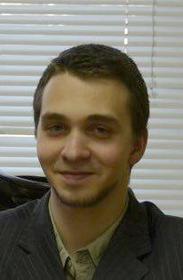
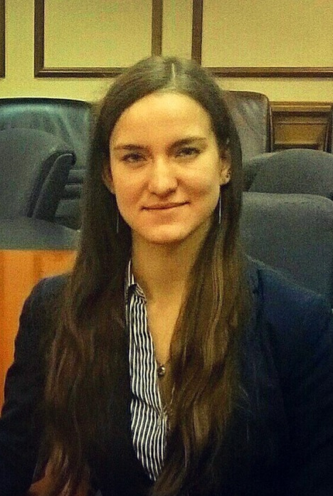
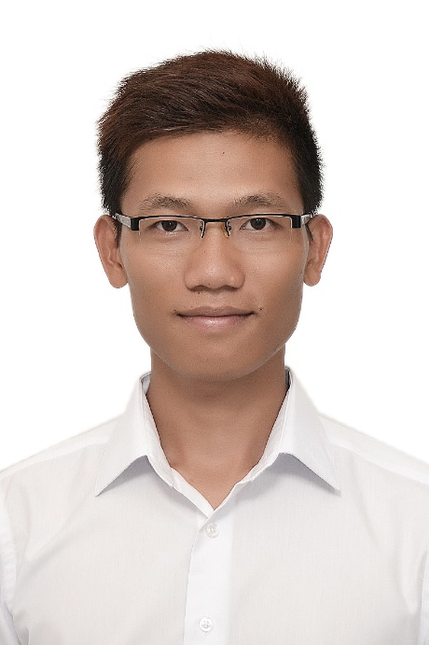
Division Supervisors
Roman Fainshmidt
[from Russia]
Darya Milkova
[from Russia]
Giang Dinh
[from ASEAN]
Rebecca Darnell
[Chief Project Consultant]

Slide 9
Thank you for your attention!

