Slide 1
School of International Regional Studies
Faculty of World Economy and International Affairs
The beacon of Russia’s achievements
Research project
December 2021 - April 2022
Moscow, 2021

Slide 2
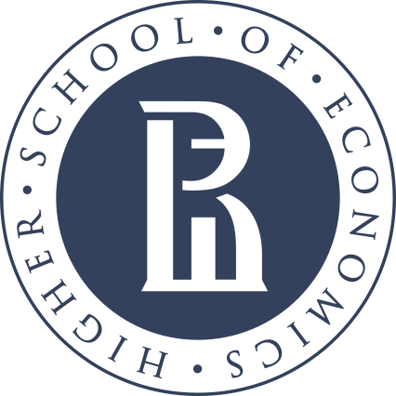
School of International Regional Studies, HSE
description
The project is aimed at expanding the relations between Russia and the APAC countries in the cultural and scientific field by attracting the attention of students of the region to the breakthroughs of Russian science. The students will examine and systematize the main Russian achievements in various fields of science and technology, collect the information about universities and scientific centers engaged in these discoveries and analyze the perspectives of the future cooperation.
Objectives:
Identify the most significant Russian achievements in science;
Assess the contribution of the breakthroughs to the world science and human development;
Assess the level of education in Russia and identify the best universities that would be attractive to foreigners;
Distinguish the most effective ways how to promote studying in Russia;
Define the prospects of Russia - South Pacific Countries cooperation in the field of education.
The goal of the project is to introduce our partners from the South Pacific with Russian scientific achievements.

Slide 3
School of International Regional Studies, HSE
Forms of project activity
Duration: 14 December 2021 – 4 April 2022;
Vacancies: 9 vacancies;
Credits: 4 credits
Activity types:
Remote work and consultations with the head of the project;
Searching for and processing information on the topic;
Preparing academic, analytical, reference and applied materials in English;
Writing posts for social media.

Slide 4
School of International Regional Studies, HSE
Grading criteria
Quality & completion of the Project Head’s assignments
Timeliness in presenting both
the midterm and final reports
Non-triviality of the conclusions & assessments

Slide 5
School of International Regional Studies, HSE
Educational Programs
Bachelor’s
International Relations;
World Economy;
Asian Studies;
HSE and Kyung Hee University Double Degree Program in Economics and Politics in Asia;
HSE and University of London Parallel Degree Program in International Relations;
Master’s
Socioeconomic and Political Development of Modern Asia;
International Relations: European and Asian Studies;
Economics, politics and business in Asia;
International Business.

Slide 6
School of International Regional Studies, HSE
Requirements for participants
Motivation letter or CV;
High level of motivation for research activities, including the one in the theoretical and historical, economic and political areas;
Understanding of the key international trends in the Asian-Pacific region;
Advanced presentation & analytical skills;
Fluency in English language;
Fluent Eastern language (Chinese / Japanese / Korean / Vietnamese / Indonesian, and others) as an advantage.

Slide 7
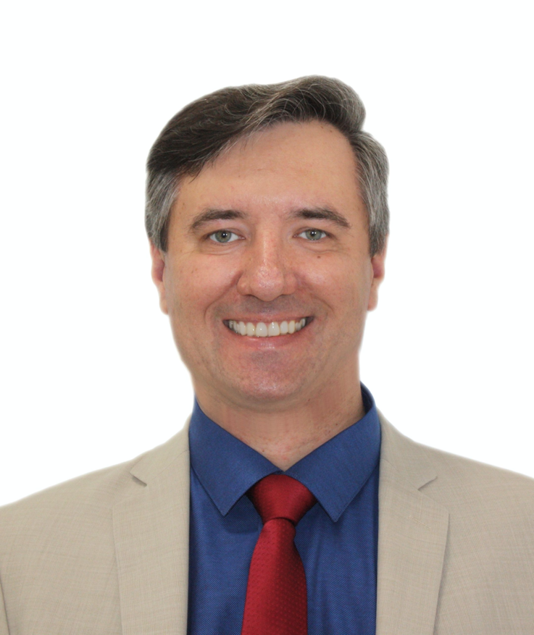
School of International Regional Studies, HSE
Project head
Professor Evgeny A. Kanaev
Professor, School of International Regional Studies, Higher School of Economics
Expert, the Russian International Affairs Council (RIAC)
Leading Researcher, Center for Asia-Pacific Studies, IMEMO RAS
Expert, ASEAN Center, MGIMO-University, MFA of Russia
Expert, Russian National Committee, Council for Security & Cooperation in the Asia-Pacific region
Member, Expert Group, the Council of the Federation Committee on Foreign Affairs, the Federation Council of the RF Federal Assembly
Expert, the Russian National Committee on BRICS Research
Member of Editorial Board of Journals:
Southeast Asia: Actual Problems of Development;
Russian Journal of Vietnamese Studies;
Russia and the Pacific;
Far Eastern Affairs
(Russia)

